Slide 1

QoS in Cellular Networks
Department of Computer Science
COMSATS Institute of Information Technology, Abbottabad
Muhammad Mateen Yaqoob

Slide 2
Second Generation Cellular Networks
Second generation were first introduced in the early 1990s
Today, many wireless service providers use second generation and 3G equipment in major markets and often provide customers with subscriber units that can support multiple frequency bands and multiple air interface standards.
Global System Mobile (GSM) supports 8 time slotted users for each 200 KHz radio channel

Slide 3
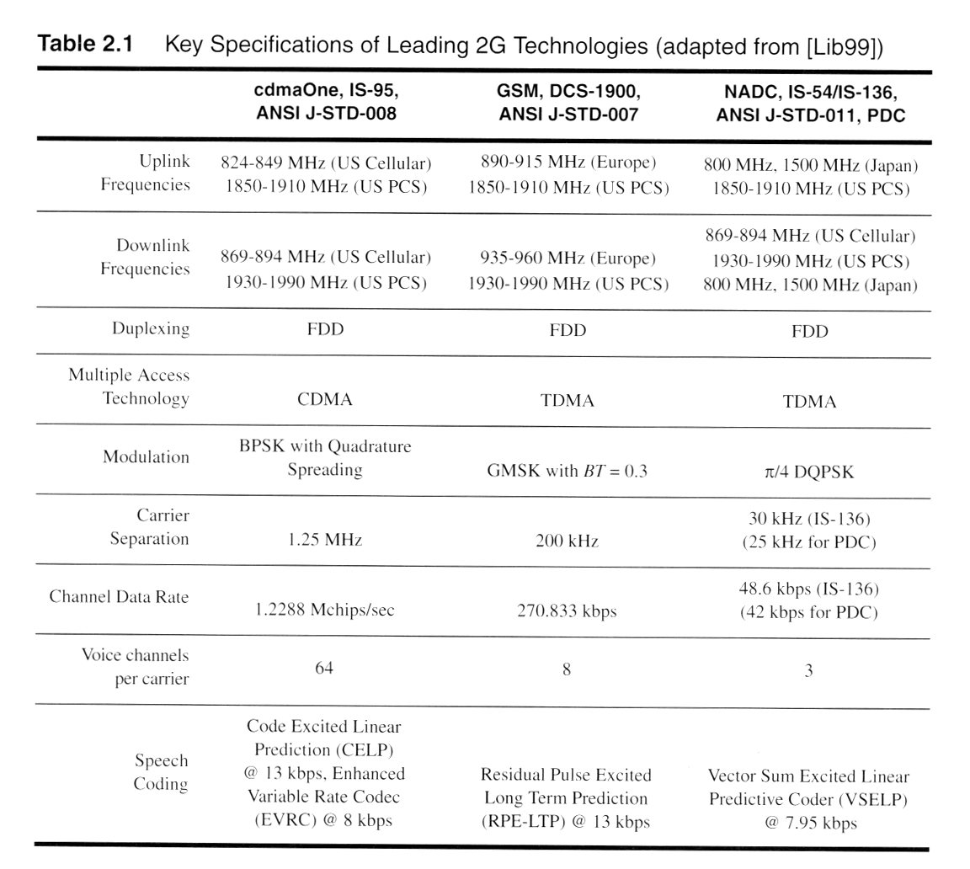
Key Specification of Leading 2G Technology

Slide 4
2.5G Mobile Radio Networks
Weaknesses of 2G
2G technologies use circuit-switched data modems that limit data users to a single circuit-switched voice channel.
Data transmission in 2G are thus generally limited to the data throughput rate of an individual user, and this rate is of the same order of magnitude of the data rate of the designated speech coders given in Key Specification of Leading 2G Technologies.

Slide 5
2.5G Mobile Radio Networks
Weaknesses of 2G
In 2G, original GSM, CDMA, and IS-136 standards which originally supported 9.6 kilobits per second transmission rates for data messages.
Due to relatively small data rates, 2 G standards are able to support limited Internet browsing and sophisticated short messaging capabilities using a circuit switched approach.

Slide 6
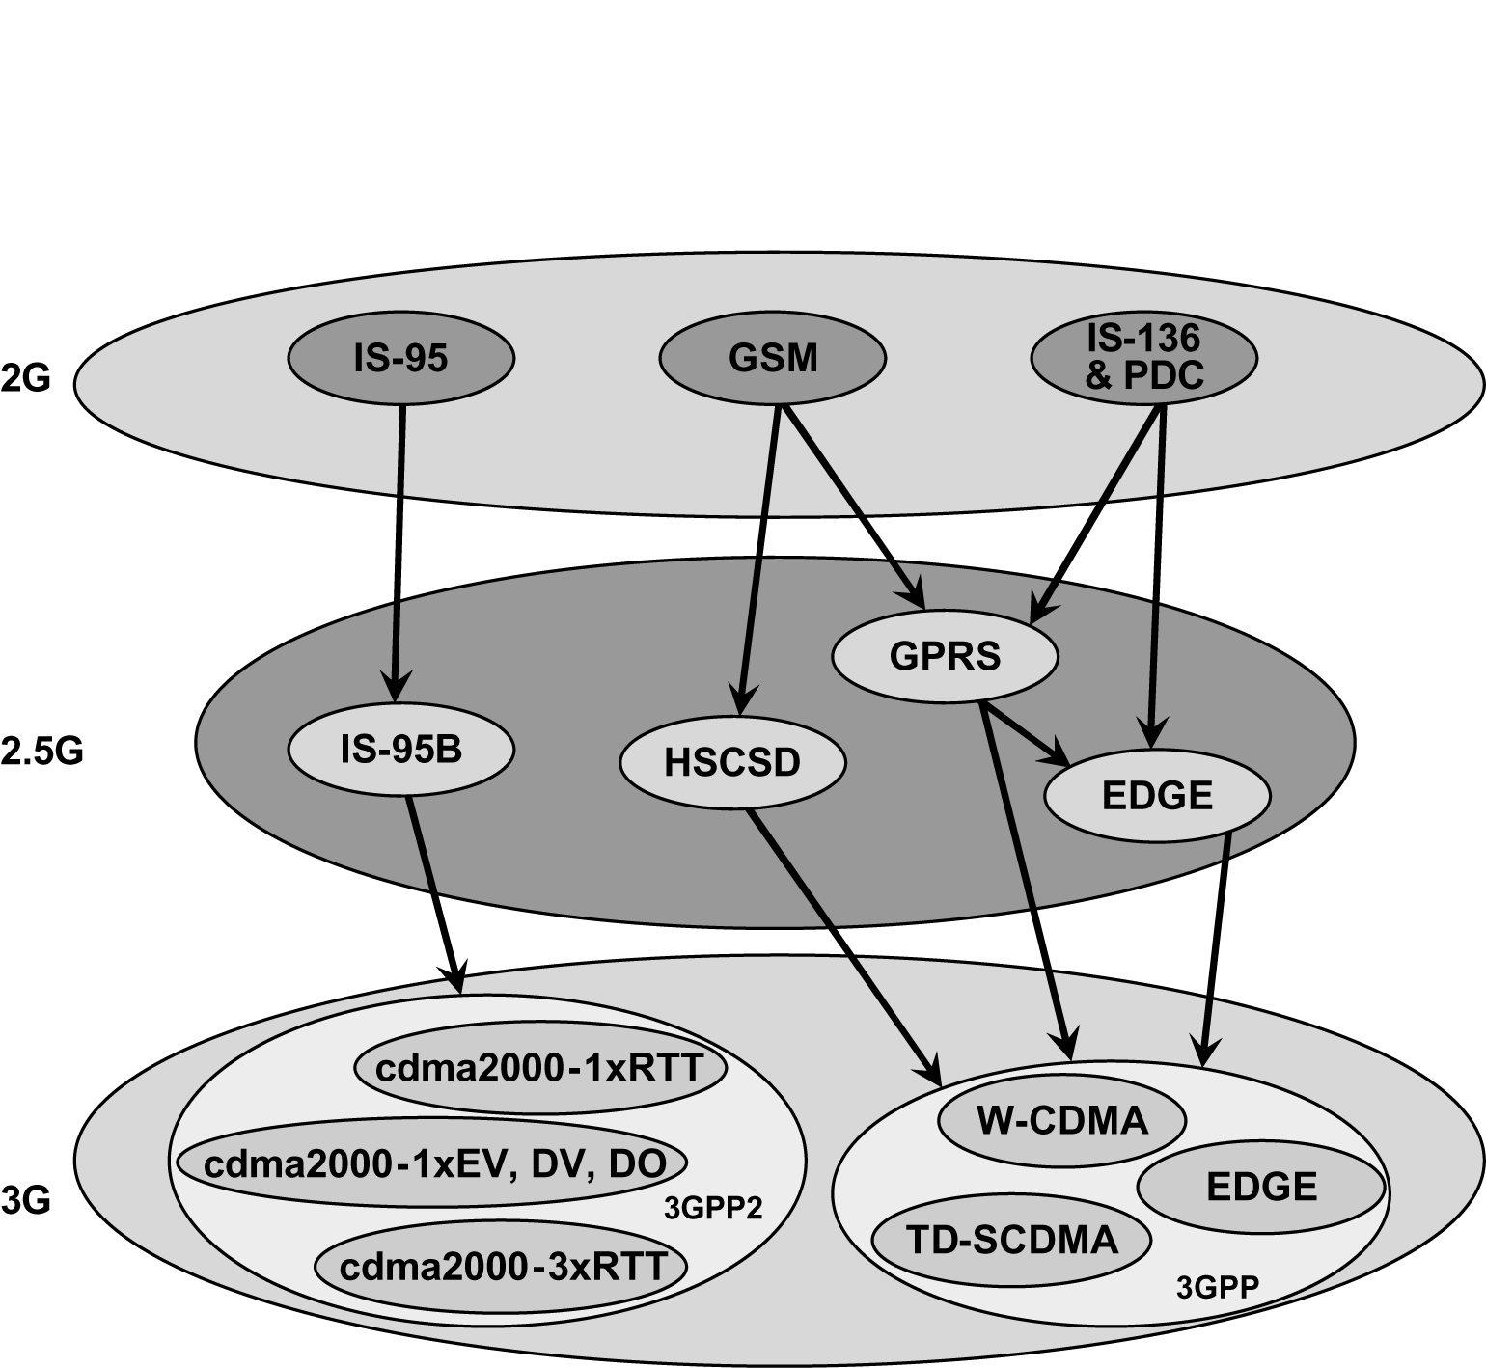
Upgrade Paths for 2G technologies
Notes:
Fig. 2.3

Slide 7
2.5G TDMA Standards
The three TDMA upgrade options include
  High Speed Circuit Switched Data (HSCD)
  General Packet Radio Service (GPRS)
  Enhanced Data Rates for GSM Evolution (EDGE)

Slide 8
GPRS for 2.5 GSM and IS-136
GPRS provides packet network and retains the same original modulation formats specified in 2G TDMA standards.
8 time slots of GSM radio channel dedicated to GPRS individual user able to achieve 171.4 kbps (21.4 kbps for one time slot)
New routers and internet gateways at base stations along with new software that redefines the base station air interface for GPRS channels

Slide 9
EDGE for 2.5 GSM and IS-136
Enhanced data rates for GSM is a more advanced upgrade to the GSM standard, and requires the addition of new hardware and software at existing base station.
EDGE was developed from the desire of both GSM and IS-136 operators to have a common technology path for 3G high speed data access.
EDGE introduces a new digital modulation format, 8-PSK (octal phase shift keying), which is used in addition to GSM’s standard GMSK modulation.

Slide 10
EDGE
EDGE allows 9 MCS(multiple modulation and coding schemes) with varying degrees of error control protection
EDGE uses adaptive capability to select best air interface
Using all 8 slots of GSM radio channel throughput of 547.2 kbps can be provided (384 kbps practical) of single user on single GSM channel

Slide 11
3G W-CDMA
W CDMA the primary focus of 3GPP (wide area cellular mobile coverage and indoor cordless type applications TDD)
WCDMA could support upto 2.048 Mbps allowing multimedia, streaming audio video and broadcasting applications
Single WCDMA 5 MHz channel each channel supporting 100 to 350 simultaneous voice calls at once depending on antenna sectoring, propagation conditions, user velocity and antenna polarizations.
Expensive new BTS equipment and deployment issues

Slide 12
3G CDMA 2000
3G CDMA Air interface cdma 2000 1 xRTT implies that a single 1.25 MHz channel is used
Can support twice as many voice users as 2G CDMA standard
Qualcomm introduced CDMA 2000 1xEV-DO
1x EV-DO dedicating radio channel to data users and supports greater than 2.4 Mbps-3.1 Mbps of high speed packet throughput per user
CDMA 2000 1x EV-DV supports both voice and data users with data rates upto 144 kbps
Notes:
RTT Radio Transmission Technology

Slide 13
4G
Also known as ‘Mobile Broadband everywhere’
  Mobile Multimedia Communication
  Global Mobility Support
  All ip based mobile broadband solution to laptop computer, smartphones, wireless modems
  Based on OFDMA, multiple antennas and Dynamic channel allocation, channel dependent scheduling for time varying conditions

Slide 14
Types of Mobile Communication Cells
The size of a cell is dictated by capacity demand
  Macro-cell
    large, covering a wide area
    range of several hundred kilometers (km) to ten km
    mostly deployed in rural and sparsely populated areas
  Micro-cell
    medium cell, coverage area smaller than in macro cells
    range of several hundred meters to a couple of meters
    deployed mostly in crowded areas, stadiums, shopping malls

Slide 15
Types of Mobile Communication Cells
The size of a cell is dictated by capacity demand
  Pico-cell
    small, covering a very small area
    range of several tens of meters
    low power antennas
    can be mounted on walls or ceilings
    used in densely populated areas, offices, lifts, tunnels etc
  Mega-cell
    These cells are formed by LEO and MEO

Slide 16
QoS in Cellular Network
4G broadband wireless technologies such as IEEE 802.16e, IEEE 802.16m, and 3GPP LTE have been designed with different QoS frameworks
  Guarantee different traffic patterns and distinct QoS requirements

Slide 17
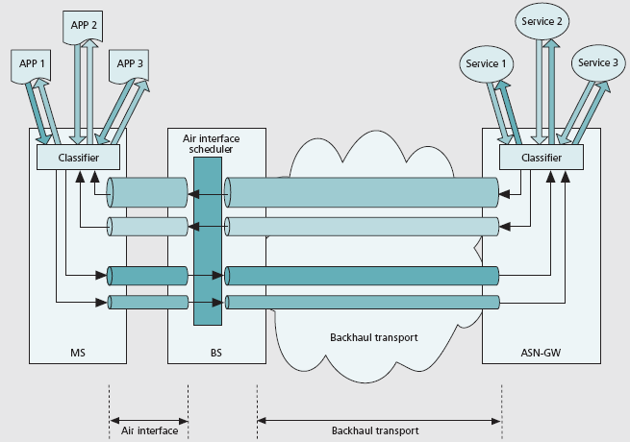
QoS in IEEE 802.16e
The QoS framework in IEEE 802.16e is based on service flows
Service Flow

Slide 18
802.16e Service Flow Management
802.16e
MS
802.16e
BS
Dynamic Service Change (DSC)
Dynamic Service Delete (DSD)
Dynamic Service Activate (DSA)
DSA_REQ
DSX_RVD
DSA_RSP
DSA_ACK

Slide 19
802.16e Service Flow ID (SFID)
 | Name | SIZE
I | Uplink/Downlink | 1
S | Maximum sustained traffic rate | 6
T | Traffic indication preference (Sleeping mode) | 1
B | Maximum traffic burst | 6
R | Minimum reserved traffic rate | 6
L | Maximum latency | 6
S | Fixed-length VS variable length SDU indicator | 1
P | Paging preference (Idle mode) | 1
R | Reserved | 4

Slide 20
Service Flow Types in IEEE 802.16
Unsolicited grant service (UGS)
  Supports real-time traffic with fixed-size data packets on a periodic basis
Real-time polling service (rtPS)
  Supports real-time traffic with variable-size data packets on a periodic basis
Non-real-time polling service (nrtPS)
  Supports delay-tolerant traffic that requires a minimum reserved rate
Best effort (BE) service
  Supports regular data services

