Slide 1

Quality Characteristics in Telecommunication
Department of Computer Science
COMSATS Institute of Information Technology, Abbottabad
Muhammad Mateen Yaqoob

Slide 2
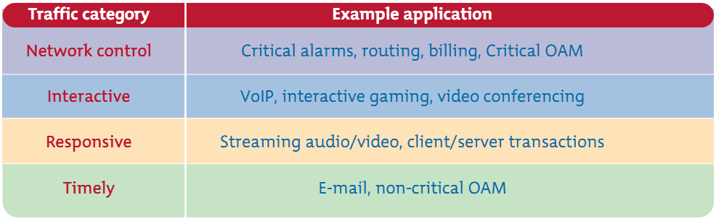
Application Traffic Categories

Slide 3
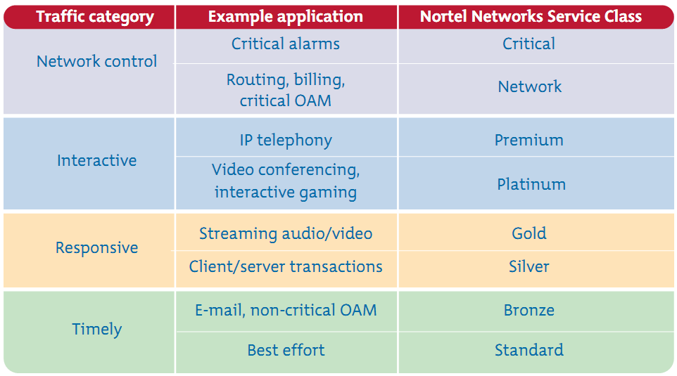
Simplifying QoS

Slide 4
QoS Requirements of VoIP
VoIP deployments require the provisioning of explicit priority servicing traffic and a guaranteed bandwidth service
These classes are;
  Voice
  Loss
  Latency
  Jitter

Slide 5
QoS Requirements of Video
Two main types of video traffic exist:
  Interactive-Video (videoconferencing) and
  Streaming-Video (both unicast and multicast).
Notes:
Interactive-Video
When provisioning for Interactive-Video (video conferencing) traffic, the following guidelines are recommended:
Interactive-Video traffic should be marked
Loss should be no more than 1 percent.
One-way latency should be no more than 150 ms.
Jitter should be no more than 30 us.
Assign Interactive-Video to either a preferential queue or a second priority queue (when supported); when using Cisco IOS LLQ, overprovision the minimum-priority bandwidth guarantee to the size of the videoconferencing session plus 20 percent.
Streaming-Video
When addressing the QoS needs of Streaming-Video traffic, the following guidelines are recommended:
Streaming-Video (whether unicast or multicast) should be marked to DSCP CS4, as designated by the QoS Baseline.
Loss should be no more than 5 percent.
Latency should be no more than 4 to 5 seconds (depending on the video application's buffering capabilities).
There are no significant jitter requirements.
Guaranteed bandwidth (CBWFQ) requirements depend on the encoding format and rate of the video stream.
Streaming-Video is typically unidirectional; therefore, remote branch routers might not require provisioning for Streaming-Video traffic on their WAN or VPN edges (in the direction of branch to campus).
Nonorganizational Streaming-Video applications (either unicast or multicast), such as entertainment video content, may be marked as ScavengerDSCP CS1, provisioned in the Scavenger traffic class and assigned a minimal bandwidth (CBWFQ) percentage.

Slide 6
QoS Requirement for Data
Data traffic characteristics vary from one application to another
QoS Baseline came up with four main classes of data traffic, according to their general networking characteristics and requirements
  Best-Effort
  Bulk Data
  Transactional Data/Interactive Data and
  Mission-Critical Data
Notes:
Best-Effort Data
When addressing the QoS needs of Best-Effort traffic, the following guidelines are recommended:
Best-Effort traffic should be marked to DSCP 0.
Adequate bandwidth should be assigned to the Best-Effort class as a whole because the majority of applications default to this class. It is recommended to reserve at least 25 percent for Best-Effort traffic
Bulk Data
When addressing the QoS needs of Bulk Data traffic, the following guidelines are recommended:
Bulk Data traffic should be marked to DSCP AF11; excess Bulk Data traffic can be marked down by a policer to AF12 or AF13.
Bulk Data traffic should have a moderate bandwidth guarantee but should be constrained from dominating a link
Transactional Data/Interactive Data
When addressing the QoS needs of Transactional Data and Interactive Data traffic, the following guidelines are recommended:
Transactional Data traffic should be marked to DSCP AF21; excess Transactional Data traffic can be marked down by a policer to AF22 or AF23.
Transactional Data traffic should have an adequate bandwidth guarantee for the interactive, foreground operations that it supports.
Mission-Critical Data
When addressing the QoS needs of Locally-Defined Mission-Critical Data traffic, the following guidelines are recommended:
Locally-Defined Mission-Critical Data traffic should be marked to DSCP AF31; excess Mission-Critical Data traffic can be marked down by a policer to AF32 or AF33. However, Cisco IP Telephony equipment currently is using DSCP AF31 to mark Call-Signaling traffic; until all Cisco IPT products mark Call-Signaling to DSCP CS3, a temporary placeholder code point, DSCP 25, can be used to identify Locally-Defined Mission-Critical Data traffic.
Locally-Defined Mission-Critical Data traffic should have an adequate bandwidth guarantee for the interactive, foreground operations that it supports.

Slide 7
Resource Allocation
Necessary for any application to run on the system
It is required for any process to allocate resource in order to run
In networks, resource can be
  Bandwidth
  Power (Energy)
  Data rate
  Buffers
  Router Processors

Slide 8
Resource Allocation
Congestion occurs when available capacity of any resource is insufficient to satisfy requirements
Proper and fair management of each resource tends to improve the overall system performance

Slide 9
Effects of Resource Allocation
Improves performance by eliminating some bottlenecks
Enables QoS guarantees
Provides isolation between traffic streams
Enhances system security by countering certain kinds of DoS attacks

Slide 10
QoS Control Mechanisms
Maximize network resource and satisfying the individual user’s QoS requirements
  Admission control
  Traffic access control
  Packet scheduling
  Buffer management
  Other (Flow & Congestion Control and QoS routing)

Slide 11
Admission Control
Validation process in which a check is performed before a connection is established to see if current resources are sufficient
Limits load on queuing system
Call Admission Control is executed to decide whether to accept or reject the call

Slide 12
  Traffic Access Control
Shapes behavior of data flows at entry and at specific points within network
Emitting traffic to network should comply with traffic descriptor
If not, excess traffic can be either dropped, tagged to a lower priority, or delayed
Filter data flows to make them conform to the expectations of scheduling algorithms

Slide 13
Packet Scheduling
Specifies the order in which queued packets are actually transmitted
Packet scheduling also enforces a set of rules in sharing the link bandwidth
Prioritizes a user’s traffic in two categories
  Delay priority for real-time traffic
  Loss priority for data-type traffic

Slide 14
Buffer Management
Sets the buffer sharing policy and decides which packet should be discarded when buffer overflows
Design of buffer sharing strategies is also very critical to the performance of the networks

