Slide 1
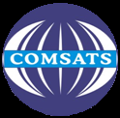
Introduction to Quality of Service (QoS)
Department of Computer Science
COMSATS Institute of Information Technology, Abbottabad
Muhammad Mateen Yaqoob

Slide 2
What is QoS?
Capability of the service providers to provide a satisfactory service.
Includes voice quality, signal strength, low call blocking and dropping probability, high data rates for multimedia and data applications etc.

Slide 3
Why QoS?
Imagine a situation where you are hardly able to hear what your friend is talking over the phone or the call gets cut when you are talking something important.
You do not want to get low quality service for paying high monthly bills.
Preference has to be given to customers who pay more to get better service, without affecting the remaining customers who pay normal amount.

Slide 4
Why QoS?
To realize all these things effective QoS schemes are needed.
Issues and schemes related to providing better QoS is the main concern of communication network service provider.

Slide 5
Historical Prospective of QoS
A century ago, public switched telephone network (PSTN) started building out a worldwide.
Circuit switched network; consisted of fixed-bandwidth, dedicated circuits and ideally was suited to carrying real-time traffic.
Five decades later, networking experts from military and educational environments introduced packet-switched networks.

Slide 6
Historical Prospective of QoS
Packet-switched networks caused a shift toward connectionless communication protocols that can handle packets that might arrive out of order.
Connection-oriented protocols such as X.25 and Systems Network Architecture (SNA), Frame Relay and Asynchronous Transfer Mode (ATM) were developed.
Real-time communications such as voice can use virtual circuits regardless of the underlying networking technology.

Slide 7
Historical Prospective of QoS
To find a more effective solution which support a combination of voice and data, integrated services offerings were introduced.
Integrated Services Digital Network [ISDN] or the IETF Integrated Services [IntServ] model.
In the late 1990’s, IP was the choice for converged networks because of its ease of use and advances in handling real-time traffic.
Notes:
The term integrated services (as in Integrated Services Digital Network [ISDN] or the IETF Integrated Services [IntServ] model) refers to the mixing of different types of traffic, such as voice, video, and data, over a single packet-switched network.

Slide 8
Historical Prospective of QoS
The key enablers for IP networks to converge successfully voice, video, and data over packet-switched infrastructures were QoS technologies.
QoS allows for the differentiated treatment of data traffic.
As QoS technologies evolved, enterprises saw the value of a single-network infrastructure and began planning toward deploying converged networks.

Slide 9
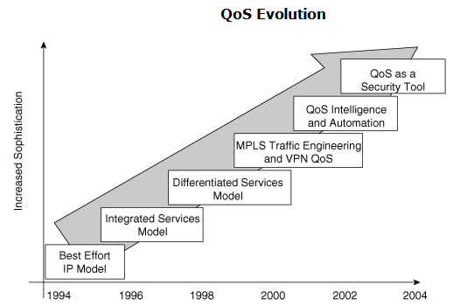
QoS Evolution

Slide 10
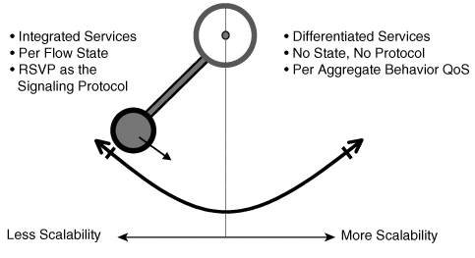
QoS Evolution
The first attempt to standardize QoS came in the mid-1990’s.
Internet Engineering Task Force (IETF) published Integrated Services Request For Comments (IntServ RFCs).

Slide 11
QoS Evolution
In the late 1990’s, QoS techniques became more sophisticated and were adapted to advanced networking technologies, such as Multiprotocol Label Switching (MPLS) and Virtual Private Networks (VPNs).
The most recent trend in QoS is simplification and automation, with the goal of efficiently provisioning "intelligent" QoS on IP networks.

